Slide 1
Fetch: Abort
As we know, fetch returns a promise. And JavaScript generally has no concept of “aborting” a promise. So how can we cancel an ongoing fetch? E.g. if the user actions on our site indicate that the fetch isn’t needed any more.
There’s a special built-in object for such purposes: AbortController. It can be used to abort not only fetch, but other asynchronous tasks as well.
let controller = new AbortController();
A controller is an extremely simple object.
It has a single method abort(),
And a single property signal that allows to set event listeners on it.
When abort() is called:
controller.signal emits the "abort" event.
controller.signal.aborted property becomes true.
Class AbortController{
get signal(){
}
abort(){}
}

Slide 2
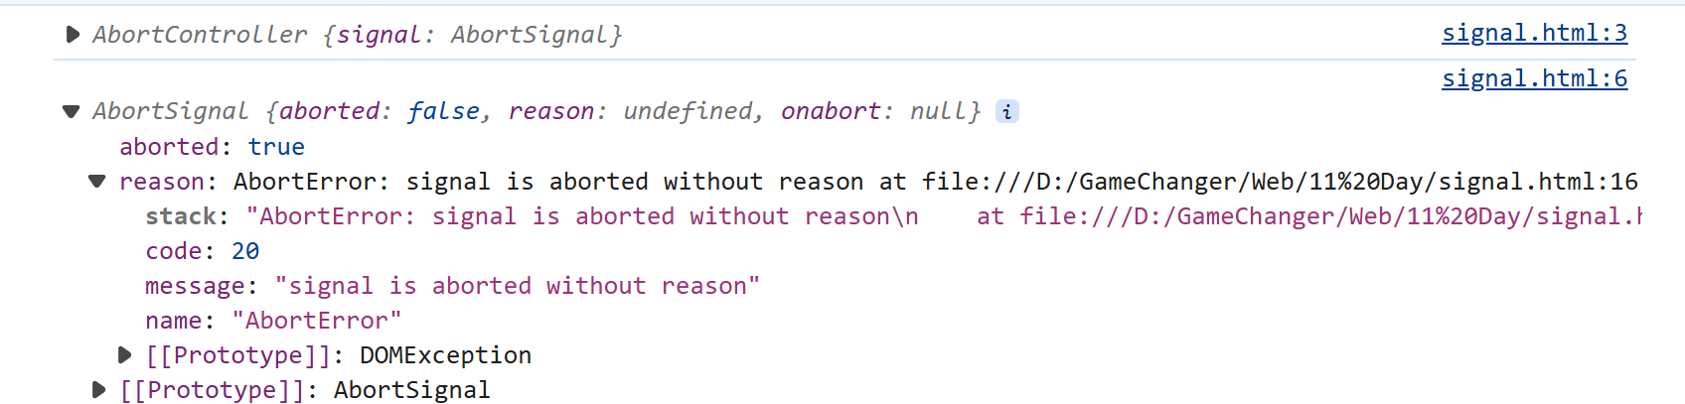
let controller = new AbortController();
let signal = controller.signal;
// The party that performs a cancelable operation
// gets the "signal" object
// and sets the listener to trigger when controller.abort() is called
signal.addEventListener('abort', () => alert("abort!"));
// The other party, that cancels (at any point later):
controller.abort();
// abort! // The event triggers and signal.aborted becomes true
alert(signal.aborted); // true

Slide 3
1. Introduction
There can be several reasons why you might want to abort JavaScript execution. Here are some common scenarios where aborting JavaScript execution might be necessary:
Long-Running Tasks: If a JavaScript task is taking too long to complete and is causing performance issues or blocking the main thread, you might consider aborting it to prevent a negative user experience or browser lockup.
User Interaction: If a user initiates an action that requires immediate interruption of a JavaScript process, such as closing a modal or canceling a request, you might need to abort the ongoing execution to respond to the user’s input
Asynchronous Operations: When dealing with asynchronous operations, you might need to abort ongoing tasks if the user navigates away from the current page or if the operation is no longer relevant.
Error Handling: In cases where a critical error occurs during JavaScript execution, aborting the execution might be necessary to prevent further cascading errors and to ensure proper error handling and graceful degradation.
Timeouts: You might want to set timeouts for certain tasks and abort their execution if they exceed a specified time limit, preventing them from negatively impacting the user experience.
Resource Constraints: In resource-constrained environments, such as mobile devices with limited memory, you might need to abort JavaScript execution to prevent excessive memory usage and potential crashes.
Security Concerns: If a script is behaving maliciously or attempting unauthorized actions, aborting its execution can help mitigate potential security risks.
Cancelling Network Requests: If you have ongoing network requests (e.g., AJAX requests or Fetch API calls) that are no longer needed, aborting them can help conserve network resources and improve performance.
Animation and Transitions: If animations or transitions need to be interrupted due to user interactions or changes in the application state, you might need to abort the ongoing animations to ensure a smooth user experience.

Slide 4
To be able to cancel fetch, pass the signal property of an AbortController as a fetch option:
// abort in 1 second
let controller = new AbortController();
Let signal= controller. Signal;
setTimeout(() => controller.abort(), 1000);
try { let response = await fetch('/article/fetch-abort/demo/hang',signal);
}
catch(err)
{
if (err.name == 'AbortError')// handle abort()
alert("Aborted!");
else
throw err;
}
AbortController is a simple object that generates an abort event on its signal property when the abort() method is called (and also sets signal.aborted to true).
fetch integrates with it: we pass the signal property as the option, and then fetch listens to it, so it’s possible to abort the fetch.
We can use AbortController in our code. The “call abort()” → “listen to abort event” interaction is simple and universal.

Slide 5
import { useState, useEffect } from "react";
import { Link } from "react-router-dom"
import { useRef } from "react";
function Listperson() {
const [employees, setEmployees] = useState([]);
const [loading, setLoading] = useState(true);
const [error, setError] = useState(null);
const controllerRef = useRef(null); //
console.log("Rendering Listperson component");
const handelabort = () => {
alert("aborting fetch request..."+controllerRef.current);
if (controllerRef.current) {
console.log("Aborting fetch request...");
controllerRef.current.abort();
setEmployees([]); // clear data
setError("Fetch aborted by user");
// cancel ongoing request
}
}

Slide 6
useEffect(() => {
let isMounted = true; // track if component is still mounted
controllerRef.current = new AbortController();
const signal = controllerRef.current.signal;
const fetchEmployees = async () => {
try {
const response = await fetch("http://localhost:8081/person", { signal });
if (!response.ok) {
throw new Error(`HTTP error! status: ${response.status}`);
}
const data = await response.json();
if (isMounted) {
setEmployees(data);
}
} catch (err) {
if (isMounted && err.name !== "AbortError") {
setError(err.message);
}
} finally {
if (isMounted) {
setLoading(false);
}
}
};
setTimeout(fetchEmployees, 2000); // simulate network delay
return () => {
console.log("Cleaning up Listperson component...");
isMounted = false;
if (controllerRef.current) {
controllerRef.current.abort(); // cancel fetch if component unmounts
}
};
}, []);

Slide 7
if (error) return <p>Error: {error}</p>;
return (
<div> {loading ? <p>Loading...</p> : null}
<h4><Link to="/create">Create</Link></h4>
<h2>Employees Data...</h2>
<table> <thead>
<tr> <th>Id</th> <th>Name</th> <th>LastName</th>
</tr>
</thead> <tbody>
{employees.map(emp => (
<tr key={emp._id}>
<td>{emp._id}</td>
<td>{emp.firstname}</td>
<td>{emp.lastname}</td>
<td> <Link to={'/emp/' + emp._id}>display</Link></td>
<td> <Link to={'/empup/' + emp._id}>Edit</Link></td>
<td> <Link to={'/empdel/' + emp._id}>delete</Link></td>
</tr>
))
}
</tbody> </table> <button onClick={handelabort}>abort</button>
</div>
);
}
export default Listperson;

